Slide 1
Help us Say Yes Webinar
Graduated Fee Schemes and
Pages of Prosecution Evidence (PPE)
2021

Slide 2
Objectives
The purpose of this session is to:
Increase the accuracy of your initial claims
By the end of the session you will understand:
What supporting information is required
Legal Aid Agency (LAA) reports
The electronic evidence assessment process

Slide 3
Location
Where are the Legal Aid Agency’s Crime Team based?
Liverpool office
Nottingham office
80 determining officers based across both sites
Birmingham office
Customer Services Team

Slide 4
Background
Yearly claims: volume/value
103,000 LGFS + 86,000 AGFS claims = £598 million
Key Performance Indicators (KPIs)
Process 90% within 15 days. We processed 100% within 7 days.
0.1% error rate or less
Quality & assurance
Quality control: 498 per month
Operational assurance: 40 per month

Slide 5
Background
Facts & Statistics
Average of 170 claims per week have an electronic evidence element
Approx. 52% of these were redeterminations in 2019. Reduced substantially: 16% redeterminations in 2021
98% are high value (£20k plus)
Processed by 23 Technical Senior Caseworkers
Majority of appeals are due the lack of PPE information, particularly in cases where electronic evidence is sought as PPE

Slide 6
Supporting Information
PPE Evidence
Additional Requirements

Slide 7
Required supporting information
For ALL claims, we require PPE evidence:
Full LAA Report from DCS
Notices of Additional Evidence [NAE]
Statement & Exhibit Indices
Correspondence from Prosecuting Authority
In certain cases we may require the following:
Case summary
Skeleton arguments
Basis of plea
Admissions
More information?
Appendix D Crown Court Fee Guidance Paragraphs 16 and 17

Slide 8
Required supporting information
In cases where electronic evidence is sought as PPE, we also require:
The discs/USB or files containing the evidence
Detailed submissions explaining the importance of the digital material to the client’s case
A detailed breakdown of the pages on disc by file/tab
Proof of Service:
NAE
LAA Report
Exhibit List
Correspondence from Prosecuting Authority

Slide 9
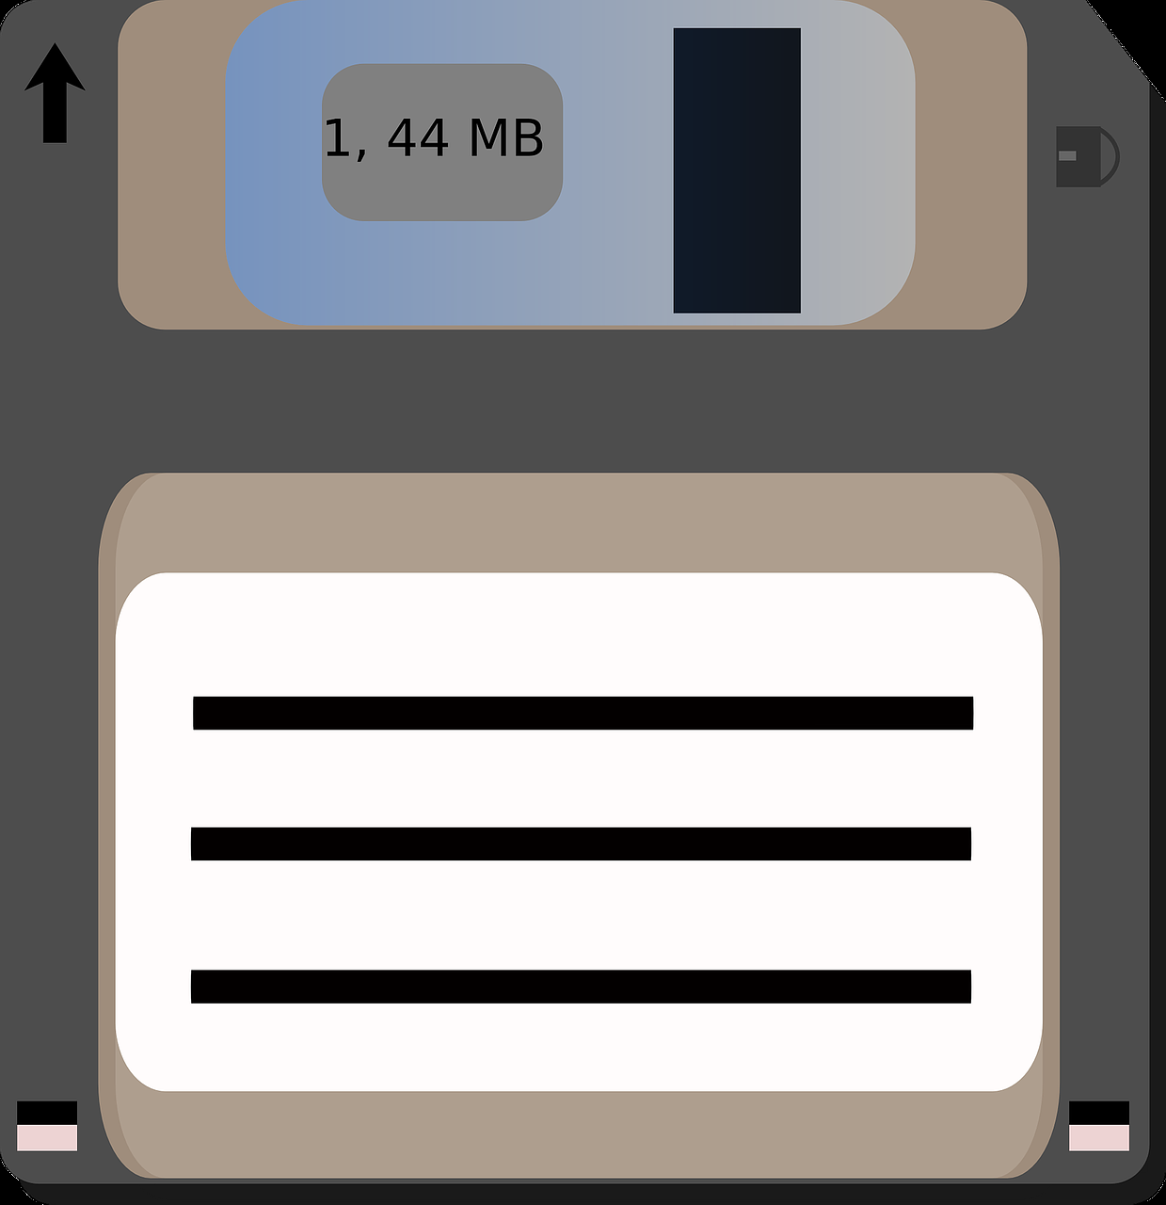
Required supporting information
Sending us evidence?
Select ‘Disk Evidence’ on CCD
Upload supporting documents on CCD
Files accepted: pdf, doc, rtf, jpeg, tiff and bmp
Max file upload: 20MB
Upload digital material on LAA’s Secure File Exchange (Galaxkey)
Send discs and USBs to LAA Nottingham in exceptional circumstances

Slide 10
LAA Reports

Slide 11
Legal Aid Agency Reports
Full LAA Report required
Duplication
Key Evidence
Statements
Exhibits
Transcripts
Streamlined Forensic Reports
Sections I, J, K & L
Cover Sheet, Title, Separator Pages
Edited Transcripts
Appendix D Paragraph 4 Crown Court Fee Guidance
Section M: Expert Reports can only be claimed if they are prosecution expert reports that are used as part of the case against the defendant
Excludes: psychiatric/medical reports re: fitness to pleas
Sections G & H: R v Andall
R v El Treki

Slide 12
Unusual circumstances
In cases where the status of material has not been resolved, we can contact the prosecution to clarify whether the material was used or not.
In terrorism and indecent images cases, where there is an undertaking not to disclose material, we can contact the CPS to verify the page count.
In all other cases where there is an undertaking not to disclose information, an application to vary the terms of the undertaking should be made so that the material can be provided to the LAA. If the CPS refuse we can liaise with them directly.

Slide 13
Electronic Evidence
Changes since 2011
Remuneration regulations
Case Law
Assessment Process

Slide 14
Changes to electronic evidence since 2011
Rep orders before 3/10/2011:
All served electronic material is subject to special prep provisions
We refuse the claim and refer the provider to Part 3 Schedule 2 Paragraph 15 CDS Funding (Amendment) Order 2007 no.3552
Rep orders between 3/10/2011 to 1/4/2012:
Only evidence served on disc which would have previously existed in paper, pre- digital age, can be allowed as PPE
Part 1, Schedule 2, Paragraph 1 (2A) CDS Funding (Amendment) Order 2011 no. 2065, i.e. statements, photos, transcripts, man-made reports, etc. served on disc (generally for convenience) should be included in the PPE
Pre-existing digital material, i.e. Excel documents and telephone data are excluded from PPE and subject to Special Preparation
Rep orders after 1/4/2012:
Evidence which has always existed in a digital format is allowed as PPE if considered appropriate by the determining officer
Part 1, Schedule 2, Paragraph 1(5) Criminal Legal Aid (Remuneration) Regulations 2013 and R v Napper

Slide 15
Electronic evidence: remuneration regulations 2013
Part 1, Schedule 2, Paragraph 1(4 & 5) Criminal Legal Aid (Remuneration) Regulations 2013
(4) Subject to sub-paragraph (5), a document served by the prosecution in electronic form is included in the number of pages of prosecution evidence.
(5) A documentary or pictorial exhibit which —
(a) has been served by the prosecution in electronic form; and
(b) has never existed in paper form,
is not included within the number of pages of prosecution evidence unless the appropriate officer decides that it would be appropriate to include it in the pages of prosecution evidence taking into account the nature of the document and any other relevant circumstances.

Slide 16
Electronic evidence: case law
Lord Chancellor v SVS Solicitors (2017)
Material relied upon by the prosecution should be allowed as PPE.
If material is relied upon and there is no Notice of Additional Evidence, the defence should not be penalised.
The status of material should be clarified and agreed between prosecution and defence at the earliest opportunity.
If there is a dispute, the trial judge can make a ruling on the status of the material.
Paragraph 50 of the judgment sets out the principles: points vii & viii (overleaf) are of significance in cases where material has been extracted and relied upon by the prosecution and there is a dispute as to the underlying source material.
R v Napper (2014)
Held that the amended definition, must be interpreted to mean that where there is insufficient evidence to establish that electronic evidence would previously have been served in paper form, then a decision on whether the material should be counted as PPE must be based on how important or integral it is to the case and the work involved in considering it.

Slide 17
Electronic evidence: case law Lord Chancellor v SVS Solicitors (2017)
Paragraph 50 (vii)
Where the prosecution seek to rely on only part of the data recovered from a particular source, and therefore serve an exhibit which contains only some of the data, issues may arise as to whether all of the data should be exhibited.
The resolution of such issues will depend on the circumstances of the particular case, and on whether the data which have been exhibited can only fairly be considered in the light of the totality of the data.
It should almost always be possible for the parties to resolve such issues between themselves, and it is in the interests of all concerned that a clear decision is reached and any necessary notice of additional evidence served.
If, exceptionally, the parties are unable to agree as to what should be served, the trial judge can be asked whether he or she is prepared to make a ruling in the exercise of his case management powers.
In such circumstances, the trial judge (if willing to make a ruling) will have to consider all the circumstances of the case before deciding whether the prosecution should be directed either to exhibit the underlying material or to present their case without the extracted material on which they seek to rely.

Slide 18
Electronic evidence: case law Lord Chancellor v SVS Solicitors (2017)
Paragraph 50 (viii)
If – regrettably - the status of particular material has not been clearly resolved between the parties, or (exceptionally) by a ruling of the trial judge, then the Determining Officer (or, on appeal, the Costs Judge) will have to determine it in the light of all the information which is available.
The view initially taken by the prosecution as to the status of the material will be a very important consideration, and will often be decisive, but is not necessarily so: if in reality the material was of central importance to the trial (and not merely helpful to the defence), the Determining Officer (or Costs Judge) would be entitled to conclude that it was in fact served, and that the absence of formal service should not affect its inclusion in the PPE.
Again, this will be a case-specific decision. In making that decision, the Determining Officer (or Costs Judge) would be entitled to regard the failure of the parties to reach any agreement, or to seek a ruling from the trial judge, as a powerful indication that the prosecution’s initial view as to the status of the material was correct.
If the Determining Officer (or Costs Judge) is unable to conclude that material was in fact served, then it must be treated as unused material, even if it was important to the defence.

Slide 19
Electronic evidence assessment process
Has all the required supporting documentation been provided?
Is the material in question used?
When was the material served / when did it become used?
Can the material in question be viewed?
What was the defendant indicted with?
What was the defendant’s role (conspiracy cases)?
At what stage did the proceedings conclude for the defendant?
What is the significance of the material to the case against the defendant?

Slide 20
Electronic and Telephone Evidence – Case Law
R v Sibanda (SCCO Ref 227/14):
Where a defendant is charged with substantive offences telephone data relating to co-defendants is not sufficiently relevant to merit inclusion in the PPE.
R v Sana [2014] 6 Costs LR 1143:
The Costs Judge held that if some electronic evidence is relevant to the case and some is irrelevant to the case, the nature of the document and the circumstances mean that it is not reasonable to treat the irrelevant material as PPE.
However, reasonable time spent considering the material could still be the subject of a claim under the special preparation rules
As well as applying the principles laid out in the regulations:
R v Napper
Lord Chancellor v SVS
We use the decisions outlined in our decision-making, particularly where the material in question is telephone evidence.

Slide 21
Electronic and Telephone Evidence – Case Law - Subdivision
R v Mucktar Khan: (SCCO Ref 2/18)
Subdivision of telephone download data is permissible and necessary to the proper application of the regulations.
The fact data is served is not sufficient to establish it relevant and should be included within the PPE.
There might be included in the served electronic material swathes of photographs of celebrities or, in some cases, pre-loaded images of national flags or other such material which is wholly irrelevant but yet served as part of the electronic material.
Whilst it is conceivable that some such material may in the particular circumstances of a case be of potential relevance and need to be considered, absent any such potential relevance it is material that the person charged with considering the evidence, should be able to check with considerable speed.
The refusal to allow such material as PPE does not necessarily mean that the representative is not paid for such work but the appropriate way of compensating the representative for such work may be by way of a special preparation fee.
The alternative approach in allowing all such material to count as PPE, no matter its obvious irrelevance or how peripheral its potential relevance, would not achieve the underlying intention of the provisions as interpreted in Jalibaghodelezhi.
Moreover, such an approach would distort the operation of the fee scheme.

Slide 22
Electronic and Telephone Evidence – Case Law – Images and Photographs
R v T Mahmood and Z Mahmood
(SCCO Ref 149/16;155/16 and 185/16)
In cases where a telephone report is served it may be appropriate to subdivide a report into its individual sections and allow only the relevant tabs or sections.
In particular, there is a distinction between “social material” i.e. audio files, images, photographs, internet history, cookies, installed applications etc that may properly be remunerated as special preparation and telecommunications data i.e. contacts, call history, SMS and other messages which is more likely to be paid as PPE.
R v Robertson
(SCCO Ref 22/17)
Personal photographs or images contained on a defendant’s telephone are unlikely to merit inclusion within the pages of prosecution evidence.

Slide 23
Electronic and Telephone Evidence – Case Law – Nature of the Case
Depending on the nature of the case and the client’s role, it may be appropriate to draw a distinction between:
Material directly attributable to the defendant which is integral to the case and should be included in the PPE
Material attributable to the co-defendant which is useful only as additional background and, therefore, payable as special preparation as per R v Yates (SCCO Ref 66/17)
R v Khadir (SCCO Ref: 85/18)
There is nothing inherently inappropriate in the notion that representatives for different defendants on the same indictments might be paid different amounts.
What is due to the representative of a particular defendant will be dependent at least to some extent on the work that has to be done in respect of that defendant.
It does not follow that every piece of evidence is going to have the same significance for every defendant. It is not reasonable for a defence team to treat all served evidence as equally relevant or potentially relevant from the outset.
At least some of it is likely to be self-evidently of no or limited relevance at the outset. PDF is the correct format for determining page count.

Slide 24
Electronic and Telephone Evidence – Case Law – Duplicate Material & Format
R v Daugnitis (SCCO ref. 154/17, 155/17, 177/17)
Where it is clear that the duplicate documents would not have required separate consideration they should only be included in the page count once.
There is a distinction between material in PDF which provides a dependable page count and is formatted in a way which permits the material to be read and printed in page format so that the printed page will reflect the page on screen and material in Excel format which does not provide a representative or predictable page count (as it is subject to the version of Excel used and the print settings of the user).
Excel data is intended to be manipulated electronically using various search tools and filters, if printed the data would become distorted and incomprehensible and may include a number of blank pages.
Depending on the circumstances of the case the appropriate method of remuneration for time spent considering or manipulating the Excel data may be special preparation which is based on actual time reasonably spent.
Where duplicate material is served in multiple formats:
A relevant consideration that the determining officer should take into account as held in R v Daugnitus

Slide 25
Electronic and Telephone Evidence – Case Law – Duplicate Material & Format
R v Greening (scco Ref: 222/18)
In determining the relevant format to calculate the PPE the question however is not whether PDF or Excel is the best format in which to work. The question is whether PDF or Excel gives the most realistic and representative page count.
In that context, one must keep in mind that the calculation of fees by reference to a PPE count dates from a time when all evidence was served on paper and that the 2013 Regulations, like their predecessors, are designed to make similar provision for documents served electronically.
The PDF format is designed to mimic presentation on paper. Excel is not, and can offer different page counts depending upon the way in which the information in that format is managed, used or presented.
50 pages of legible data on paper will, if reproduced in PDF format, remain 50 pages of legible data with much the same appearance. In Excel format, depending on how the same data is managed or presented, the page count could run into hundreds.

Slide 26
Electronic and Telephone Evidence – Case Law – Duplicate Material & Format
Upscaling documents
R v Zigaras and Nikontas (SCCO Ref: 155/18):
In cases where the prosecution rely on telecoms data that is a combination of call and cell site data, making a 32-column spreadsheet, it may be appropriate to upscale the document if the type is too small to be read in A4 when the PDF is printed.
In this case, the court concluded that the data could only reasonably be read in A2 size, which meant multiplying the PDF page count by 4.
This issue will only arise where call and cell site data are combined and the Page 81 of 126 resulting data is too small properly to read if printed in A4.
Not all telecoms companies present their data in this way.

Slide 27
Other things we’ll consider
As part of the assessment process, the determinising officer will also take into account, where possible and practical, assessments made in respect of the co-accused as well as the corresponding litigator/advocate claim.
If the litigator and advocate are from the same firm, we require that both of their names be supplied to ensure that there is no duplication of work pertaining to the electronic material, as per R v Napper & R v Hennessey.

Slide 28
Appeal Process
If an assessment has been made and you are dissatisfied, you have 21 days - from the assessment notification - to lodge a redetermination
If a redetermination is lodged, you will need to resubmit the electronic material
If your redetermination request is refused or part authorised, you have the right to request written reasons within 21 days of receiving the redetermination notification
If a written reasons request is lodged, you will need to resubmit the electronic material
Once the written reasons have been supplied, you can lodge a Form A at the SCCO

Slide 29
What’s next?
Due to AGFS changes, the impact of PPE and subsequently claims, where electronic material is sought as PPE, has decreased
Electronic Evidence and PPE continue to be key drivers of the LGFS Scheme
The LAA are continually improving consistency in electronic evidence assessments: The billing teams are determined to process these claims accurately and expeditiously
We are working with our Central Legal Team to improve communication between the LAA and SCCO
The Crime Case Management Directorate has set up a Provider Engagement Working Group.

Slide 30
Guidance and support
For further information please see:
Appendix D Crown Court Fee Guidance Paragraphs 16 and 17
Criminal Legal Aid Remuneration Regulations
Secure File Exchange (Galaxkey)
Lord Chancellor v SVS Solicitors (2017)
https://legalaidlearning.justice.gov.uk
Customer Services Team:
Tel: 0300 200 2020
Press ‘2’ for Criminal Legal Aid
(Limiting calls to ‘urgent’ queries or requests will allow us to process applications and claims faster)
litigators-fee@justice.gov.uk – litigator queries
advocates-fee@justice.gov.uk – advocate queries

