Slide 1
The Family Advocacy Scheme (FAS)
Helping Us to Say Yes
15 February 2022
V1.0

Slide 2
Technical tips for this webinar
Please put yourself on mute during the webinar
You can ask us questions at the end of each session through the ‘meeting chat’
Click on the ‘meeting chat’ to ask a question
You can keep the meeting chat open throughout to view other people's questions
Email us if you experience technical issues during the webinar:
communicationsdepartment@justice.gov.uk
Camera and audio off when icons appear like this:
Click here to view the meeting chat

Slide 3
Content
General Hints and Tips
Multi-Day Interim Hearings
Final Hearings
Advocates Meetings
Uploading Documents
Useful Links

Slide 4
Family Advocacy Scheme: General

Slide 5
Family Advocacy Scheme: General ..
Single Fee Per Hearing
Only one fee per hearing may be claimed under the FAS. Where different matters concerning your Client are dealt with together by the court, whether listed together or listed consecutively, they should be treated as one hearing for the purposes of the FAS:
7.125 2018 Standard Civil Contract
Where multiple parties are represented by one advocate and the applications are dealt with together by the court, only one fee is payable for the hearing:
15.20 - 15.21, Appendix 2, Costs Assessment Guidance 2018
Top Tip:
The guidance above applies to all activities under the FAS:
Including: Advocates Meetings, Conferences and Advocates Bundle Fees.

Slide 6
Family Advocacy Scheme: General ….
Individual Costs Allocation
Each counsel is allocated their own cost allocation on CCMS
There must be sufficient allocation to cover the costs of counsels’ claims for the LAA to pay counsels' bill
It is highly recommended that chambers request access to a case and agree an individual costs allocation when counsel is first instructed
The individual costs limit can be amended by the instructing solicitor during the case
The current individual costs allocation and amounts claimed/paid to date can be confirmed on the Case Statement of Account screen on CCMS (see slide 7)
Advocate Quick Guide: Request Access to a Case
Top Tip:
Only allocate the NET of Counsels’ costs. Do not include VAT in counsel's costs allocation.

Slide 7
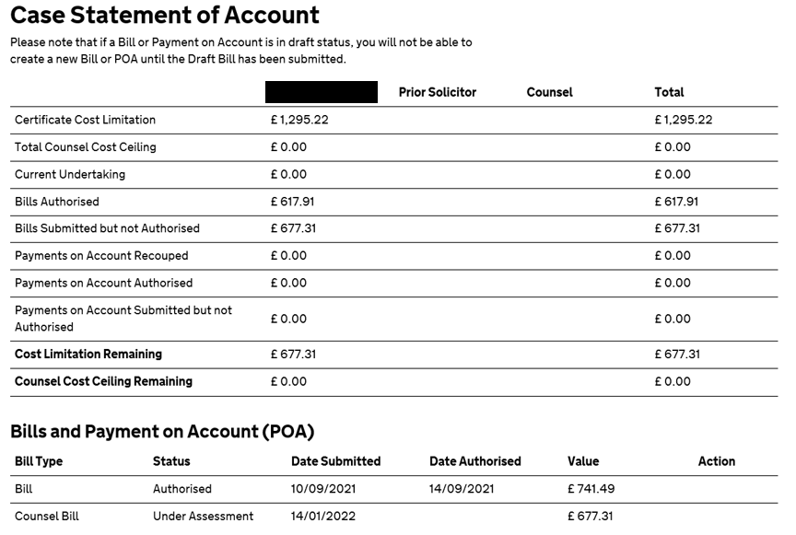
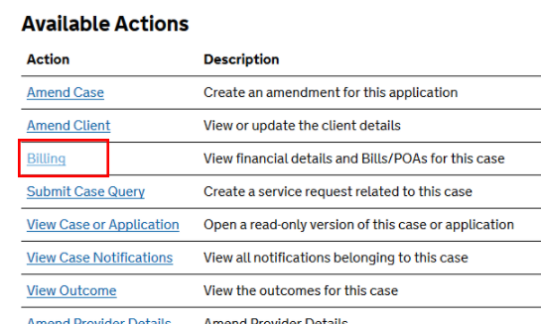
Family Advocacy Scheme: General ……….
Individual Costs Allocation: Example of Case Statement of Account
Top Tip:
To access the case statement of account page:
Navigate to the Case Overview Screen
Scroll down to the Available Actions
Select Billing

Slide 8
Family Advocacy Scheme: General.
Section 9 Judge (Section 9 Senior Courts Act 1981)
Section 9 Judges sit as judges of High Court level
High Court FAS fees will apply where a hearing is heard by a Section 9 Judge
8.4 Civil Finance Electronic Handbook
VAT
From 1st January 2021 VAT may only be claimed where the work was undertaken whilst your clients usual place of residence is in the UK
4.24 - 4.34 Costs Assessment Guidance 2018
Please check with the instructing solicitor to ensure VAT applies. Please refer to HMRC to confirm if VAT applies
11 Civil Finance Electronic Handbook
Top Tip:
Make regular checks with counsel to ensure their VAT status is correct and has not changed. Changes to VAT status can be sent to ProviderRecords-London@justice.gov.uk

Slide 9
Multi-Day Interim Hearings

Slide 10
Multi-Day Interim Hearings
When an interim hearing runs over multiple days, the fee is calculated based on the cumulative time of the hearing excluding any adjournments for lunch or overnight
14.6, Appendix 2, Costs Assessment Guidance 2018
This can apply to non-consecutive days if the court consider both days to be part of the same hearing
Multi-day interim hearings should be claimed as a single line on CCMS. CCMS allows hearings of up to 15 hours to be entered.
If the total time exceeds this, please add a second line for the remaining number of Hearing Units.
Top Tip:
If the court orders do not make the position clear, please clarify within your bill narrative.
Top Tip:
Use the FAS Multi Day Unit Calculator page of the LAA’s Civil Claims Rates Calculator to calculate the correct rate.

Slide 11
Final Hearings

Slide 12
Final Hearings
To be payable as a final hearing, the hearing must be listed as, and expected to be, the contested final hearing
7.127 2018 Standard Civil Contract
The hearing will be considered an interim hearing if it is listed as a final hearing but is adjourned or postponed before the substantive issues are considered
6.4 Civil Finance Electronic Handbook
A final hearing fee will apply if a certificate covers multiple Aspects (domestic abuse, children or finance) and a hearing is listed as a contested final hearing for one Aspect, but, acts as an interim hearing for other aspects
7.127 2018 Standard Civil Contract
Top Tip:
Upload a copy of the court order listing the final hearing with your claim. Whilst this is not mandatory, the additional information can help us to clarify if the correct fee has been claimed.

Slide 13
Final Hearing Fees for Other Hearings
Finding of Fact Hearing
A finding of fact hearing is claimable at final hearing rates (subject to it being effective)
This applies to both private law (7.128(b) 2018 Standard Civil Contract) and public law (7.129 2018 Standard Civil Contract) proceedings
Issues Resolution Hearing (IRH)
In public law proceedings, if a case is concluded at an IRH and therefore does not proceed further, this hearing should be claimed at final hearing rates.
7.128(a) 2018 Standard Civil Contract
Where there is joint representation of children, if the Court makes a final order for one child, but lists further hearings for other children, an interim fee would be applicable for the IRH because the case has not concluded.
Any directions hearing, or other form of interim hearing, including Dispute Resolution Appointment in Private Law Children proceedings or a Case Management Hearing that concludes proceedings is not a ‘Final Hearing’ for the purposes of FAS.

Slide 14
Advocates Meetings

Slide 15
Advocates Meetings
Advocates meetings are claimable in Public Law proceedings only where they are ordered by the Court
There is no limit to the number of advocates meetings that can be claimed. However, when two or more have already been paid, the court order must be uploaded
The rate is determined by the level of Judge at the related hearing i.e. the hearing following the advocates meeting. The level of Judge should be evidenced within your claim
14.17-14.20, Appendix 2, Costs Assessment Guidance 2018
6.4 Civil Finance Electronic Handbook
The only bolt-on claimable with an advocates meeting is the exceptional travel bolt-on
15.13, Appendix 2, Costs Assessment Guidance 2018
Top Tip:
It is good practice to upload the order listing the advocates meeting for every claim. This prevents the claim being rejected in the event that two advocates meetings have already been claimed.

Slide 16
Supporting Documents

Slide 17
Supporting Evidence
Court orders should include the start and end times of any hearings. Please include details of any adjournment. Please record Bolt-ons and Advocate Bundle fees in the court order
When the court order does not include these details, provide further evidence to support these costs: EG: counsels’ attendance note
The start and finish times must be provided for a conference fee to confirm it is not part of the hearing fee
Please upload a copy of the advice for an opinion fee
6.11 Civil Finance Electronic Handbook
Evidence should also be provided in support of any travel expenses. For public transport, over £20, a copy of the ticket, or a receipt, should be uploaded with the bill
10.2 Civil Finance Electronic Handbook
Top Tip:
When court orders are uploaded in support of a FAS fee, highlight any relevant directions within the order. This will help to ensure the claim is not rejected, or assessed in error, and will help avoid unnecessary delays in payment

Slide 18
Uploading Documents
Uploading incorrect documents with counsels’ bills will cause delays to your payment as the claim will be rejected: EG: The documents relate to different hearings, counsel or cases
The LAA will also report and investigate a security breach in these cases
In turn, this will create additional work for chambers and the LAA. Counsel will need to resubmit their bill with the correct supporting documents. They will need to assist with the LAAs’ investigation into how this happened
Please ensure the correct documents are uploaded to avoid this and they relate to the fee being claimed
Claims against an incorrect certificate may cause delays to payments
The LAA will compile a report and investigate the security breach
When the issue is identified, additional work is needed by the LAA and chambers. You will need to claim the fee under the correct certificate
When a fee is paid in error, under the wrong certificate, there will be issues with your accounting in the future
10.12 Costs Assessment Guidance 2018

Slide 19
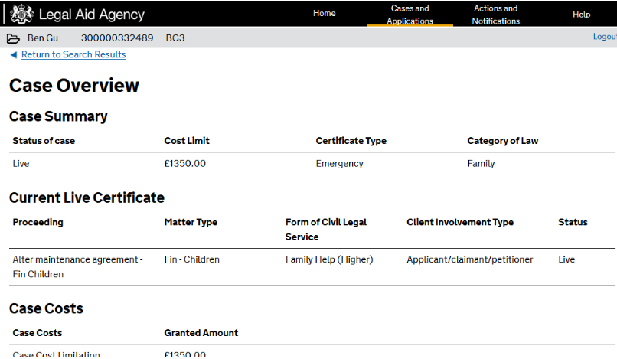
Uploading Documents: Top Tip
Top Tip:
The CCMS Case Overview screen provides a brief overview of the case details. This includes the proceedings covered by the certificate.
As per standard contract:
A copy of the certificate must be provided by the instructing solicitor when counsel is first instructed.
The certificate confirms the scope covered and any limitations. It may include the name of the opponent.
To help us to identify the correct case:
Please check the certificate to ensure the work is covered under which counsel should claim their fee.

Slide 20
Useful Links

Slide 21
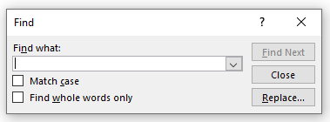
Family Advocacy Scheme Guidance
7.100-7.158 2018 Standard Civil Contract
Appendix 2, Costs Assessment Guidance 2018
Chapter 6, Civil Finance Electronic Handbook
Remote Family Hearings: Updated Ways of Working
Civil Claims Rates Calculator
Legal Aid Learning Website
Top Tip:
The above documents are fully searchable PDFs. You can search for a key word using ‘Ctrl + F’ if you are not sure where to find the information you need.

Slide 22
Our training website
CCMS Quick Guides
CCMS Online Training
Online Support Webchat
Use Webchat for help with IT system issues
Webinar Recordings
Our ‘Help Us Say Yes’ webinars focus on areas where there have been issues or high enquiry levels
Sign up on ‘Eventbrite’
Popular sessions are posted on the training website: Ministry of Justice
CCMS Advocate: Getting Started
CCMS Advocate: Submitting Bills
Calculate a FAS Fee (Advocates) - Interactive Module
Bulk Claim Upload – Solving Problems

Slide 23
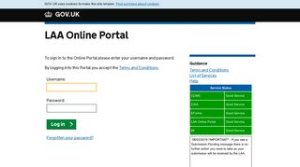
Our communications channels
Legal Aid Bulletin
Social Media
LAA Portal
A fortnightly e-alert with links to relevant pages
Follow us on Twitter
We post the status of our online systems on the portal’s home page
Join our thousands of subscribers
Read our blog
Get help from our customer service twitter account
Contact the presenters: Chris.Needham@justice.gov.uk
Tristan.Cooke@Justice.gov.uk

Slide 24
End slide

